Slide 1



Searching for blind faults: the Haiti subsurface imaging project
ERAY KOCEL
with
Robert R. Stewart, Paul Mann,
Li Chang and Anoop William
University of Houston

Slide 2
Outline
Introduction
      At 2010, Haiti was struck by a magnitude 7.0 earthquake
      Project with many aspects:
            Geophysical: Acquisition & processing & interpretation
            Humanitarian and technical
Survey Area & Geology
      Main strike slip fault (Enriquillo–Plantain Garden fault zone, EPGFZ)
      Recent studies proposed slips on previously unrecognized, neighboring faults (Léogâne)
Survey Acquisition Details and Location
      600 m P-wave cable line
      600 m S-wave cable line
      4 km P-wave Node line
Data Processing
            Successful image of 800 ms for P-AWD line
Summary
      Discontinuity profiles with prominent velocity transitions

Slide 3
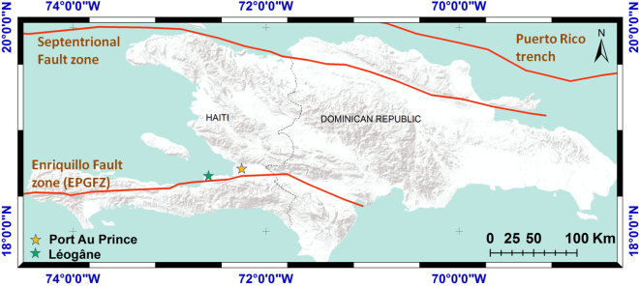
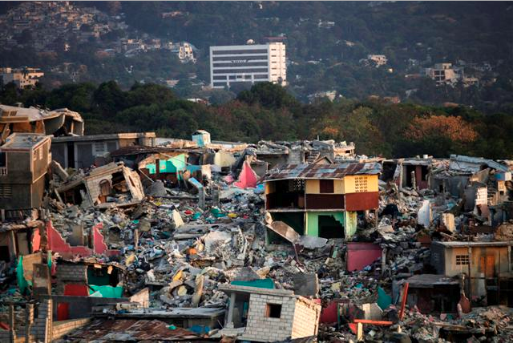
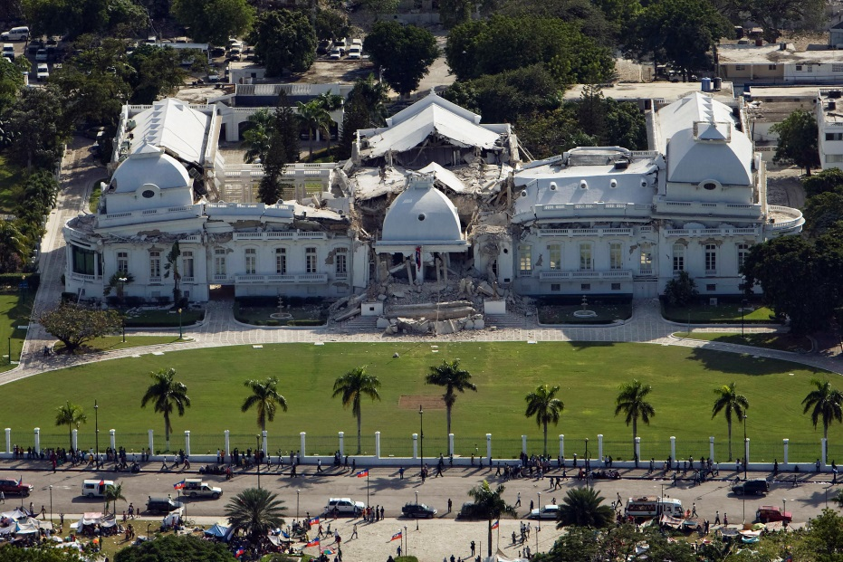
Introduction
On 12 January, 2010, Haiti was struck by a magnitude 7.0 earthquake. An estimated three million people were affected by the quake and the death count was estimated at 220,000.
Vital infrastructure loss. This includes hospitals in the capital; air, sea, and land transport facilities; and communication systems.
Recent studies proposed that the main slip were on previously unrecognized, neighboring faults (Léogâne)
There are blind thrust faults associated with the Enriquillo-Plantain Garden fault system over which Haiti lies
wikipedia

Slide 4
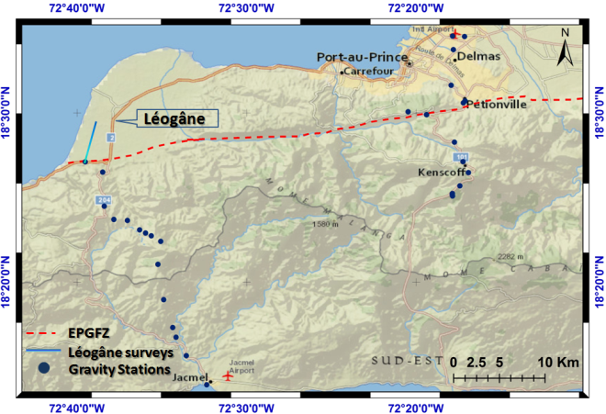
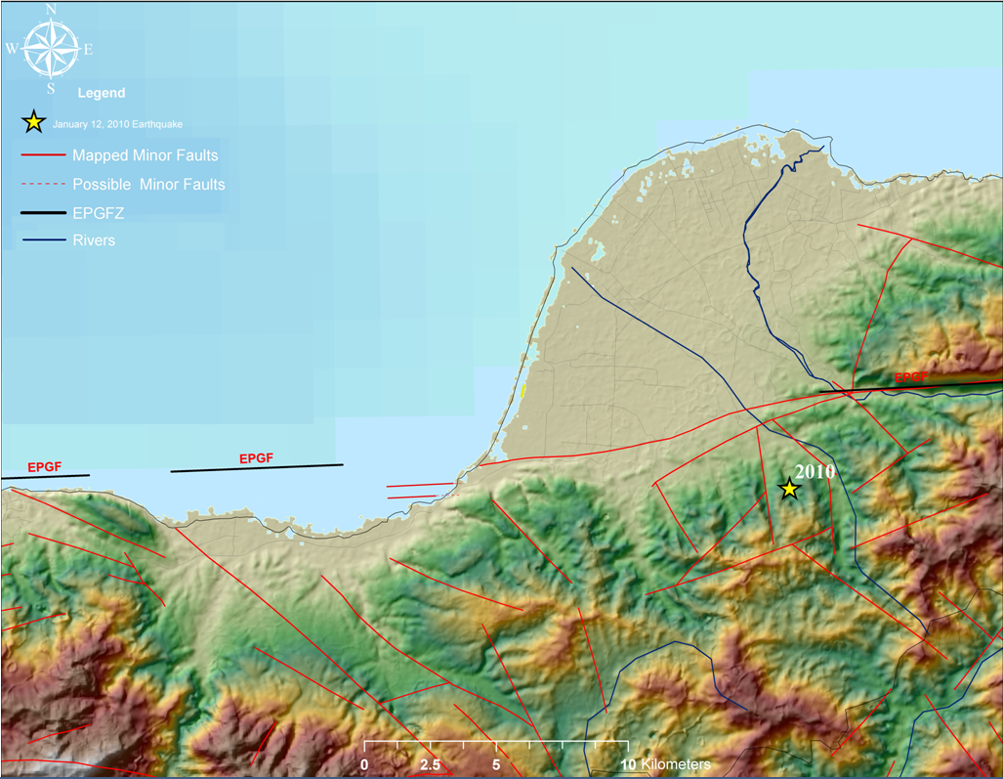
Survey Area & Geology
Over 5km of 2D seismic line at Léogâne area
Gravity survey along the seismic profile
25 km wide spread gravity survey from Jacmel to Léogâne
10km wide spread gravity survey around Petionville area
Léogâne fan: filled with soft sediments, how thick?, underlying rock type?
Characterizing near-surface sediments physical properties
Image proposed blind Léogâne Fault, dipping angle? , direction? , depth?

Slide 5
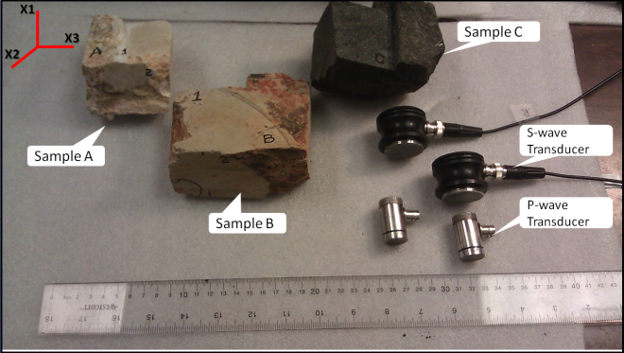
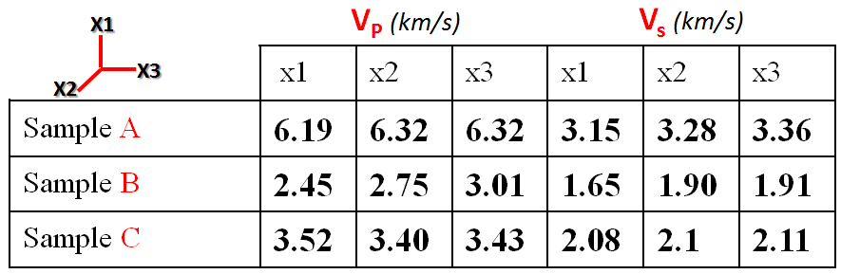
Lab. Measurements
Sample B is the expected bedrock type for Léogâne surveys
metamorphosed limestone
layered limestone
highly degraded igneous rock (most likely basalt)

Slide 6
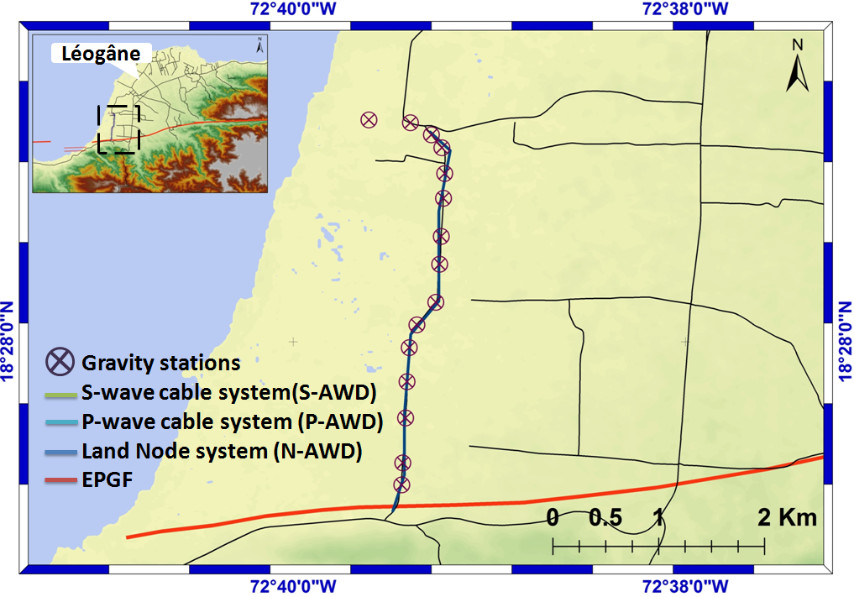
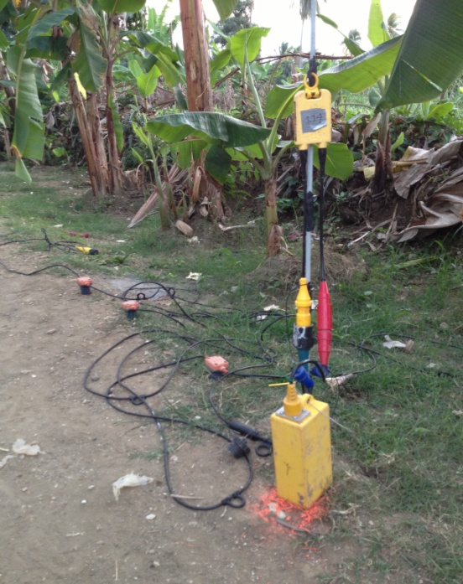
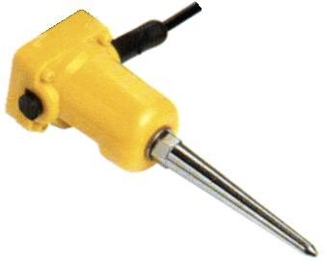
Survey Area & Acquisition
HDR
P-AWD Line: 600 m long
5 m shot and receiver spacing
Vertical weight drop with vertical geophones
3 x 1C geophone
N-AWD Line: 4 km long
10 m shot and receiver spacing
Vertical weight drop with vertical geophone array
S-AWD Line: 600 m long
5 m shot and receiver spacing
Tilted weight drop with horizontal geophones
Battery

Slide 7
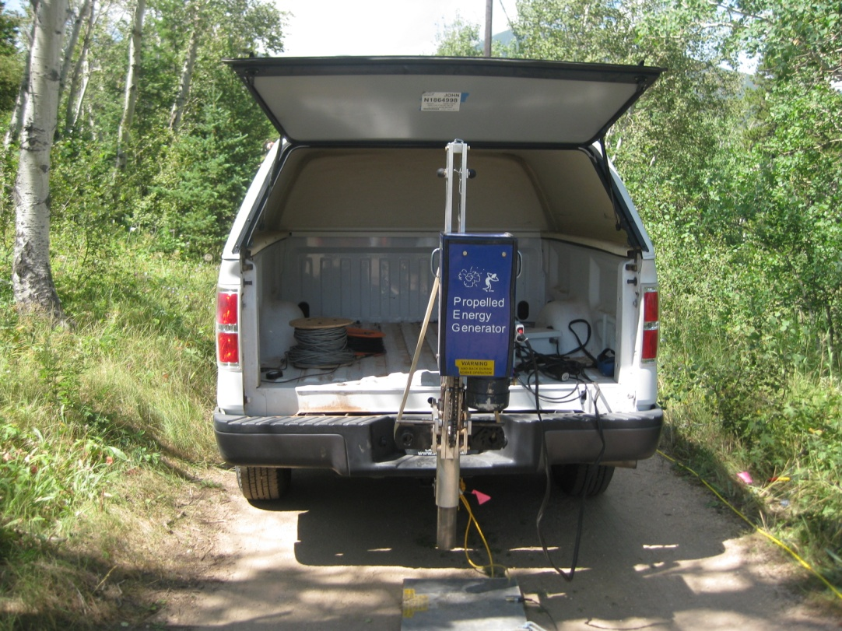
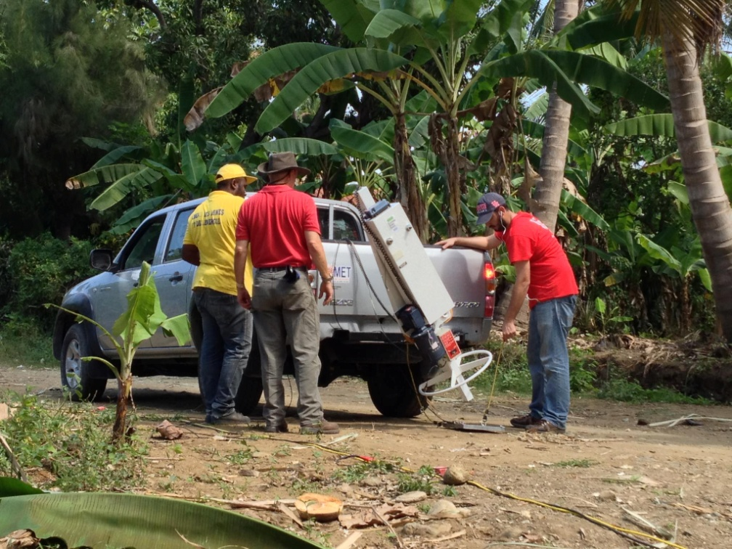
Acquisition Details
Propelled P-wave source
100 lbs. hammer
Propelled S-wave source
100 lbs. hammer

Slide 8
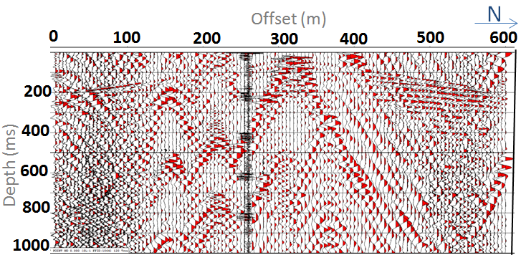
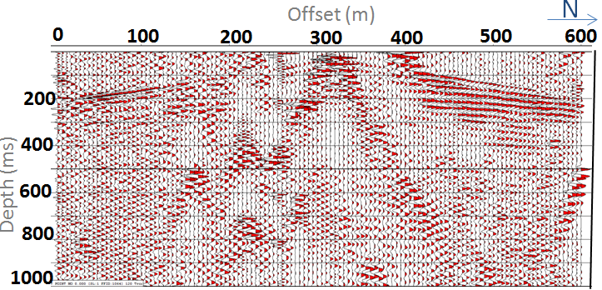
Processing
Random noise: Populated village area
Band pass filter: 25 Hz – 110Hz
Limited bandwidth: deepest reflection is at 800 ms

Slide 9
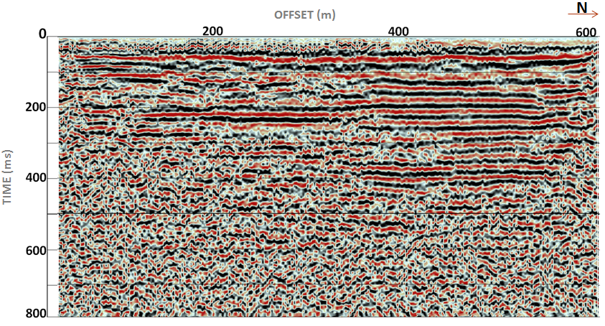
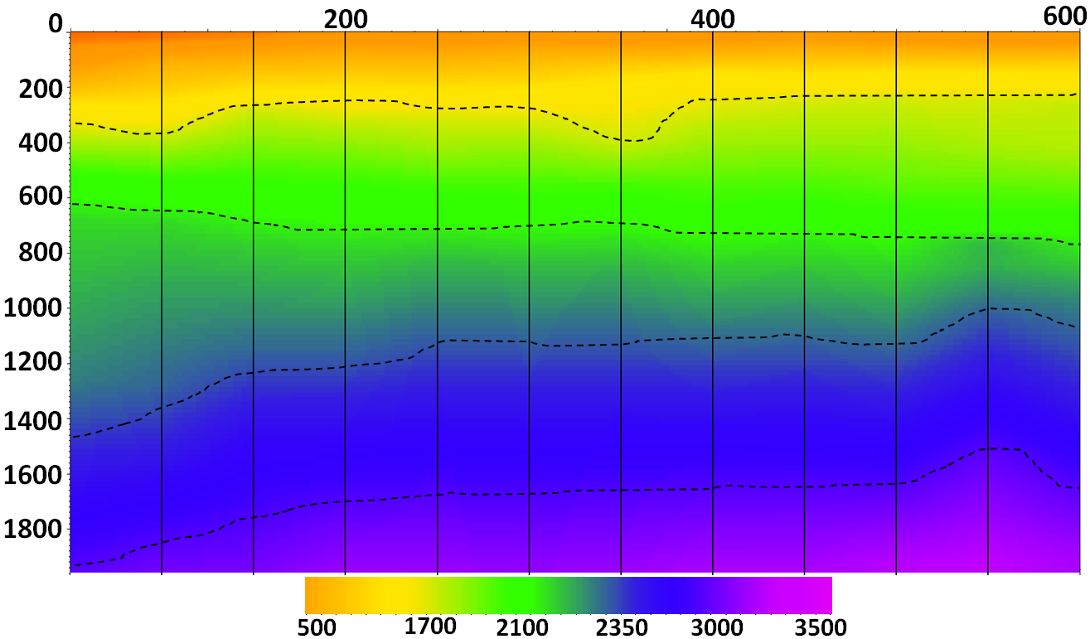
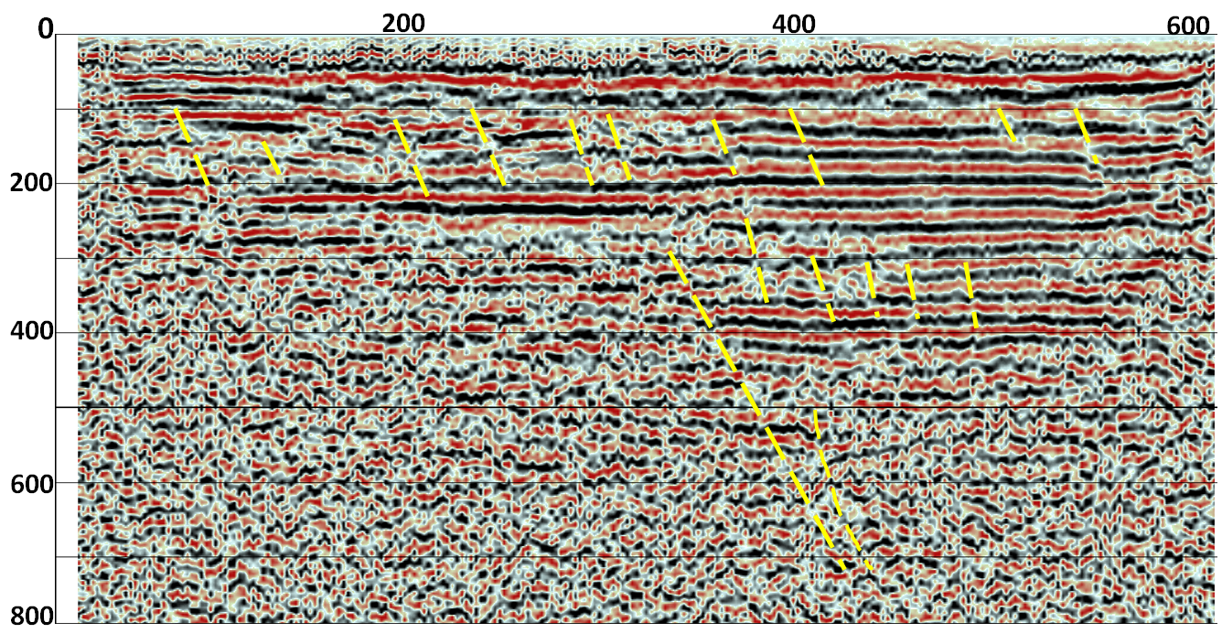
Results: P-AWD
OFFSET (m)
N
TIME (ms)
m/s
Stacking velocity section shows several transition zones
The CMP stacked section shows multiple discontinuity profile

Slide 10
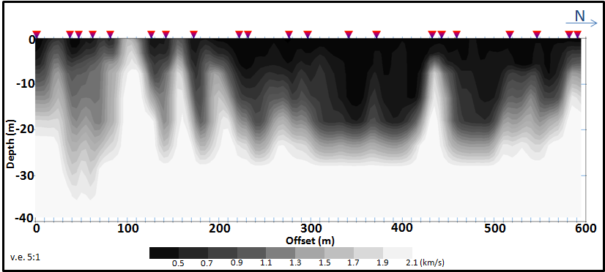
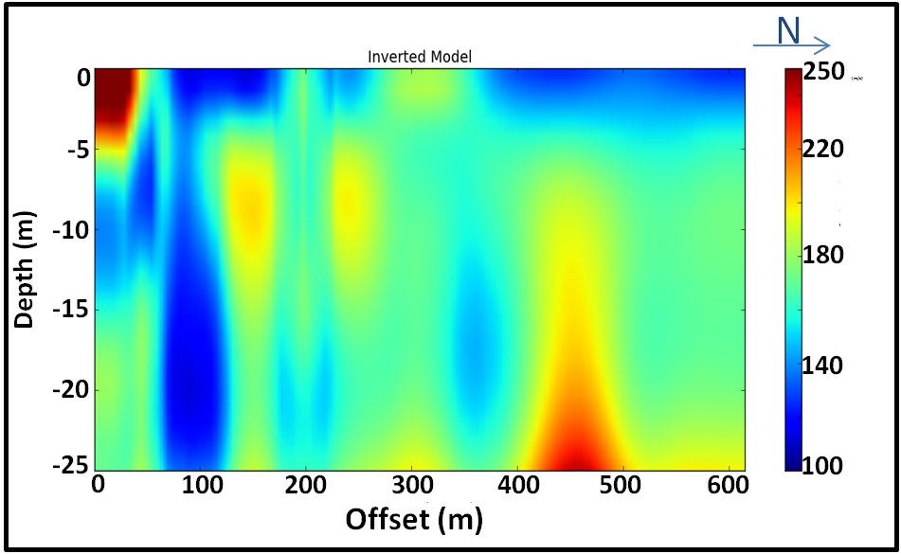
Results: P and S Wave Refraction Analysis
V_{p} structure
Selected shots
V_{s} structure
Velocity transitions at similar offset

Slide 11
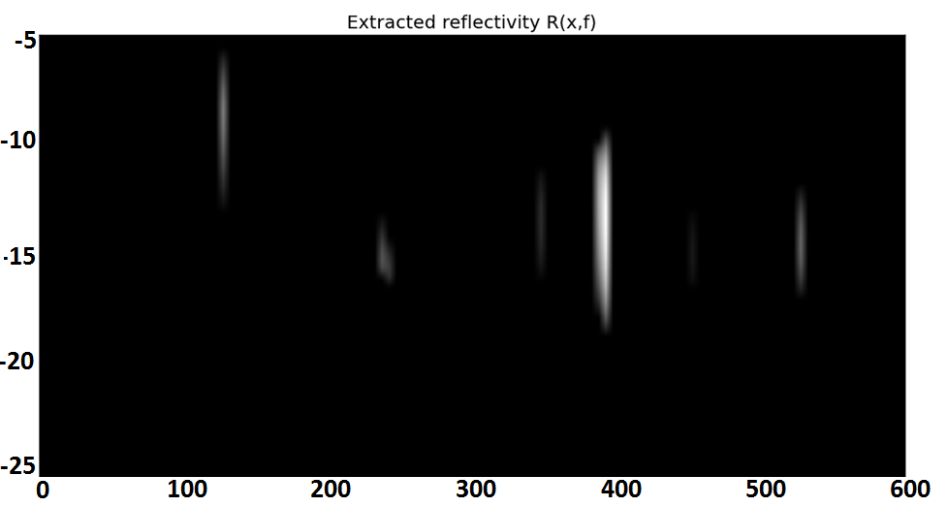
Results
N
OFFSET (m)
Discontinuity profiles
TIME (ms)
N
Reflectivity match with interpreted fault locations
DEPTH (m)
Courtesy of Craig Hyslop

Slide 12
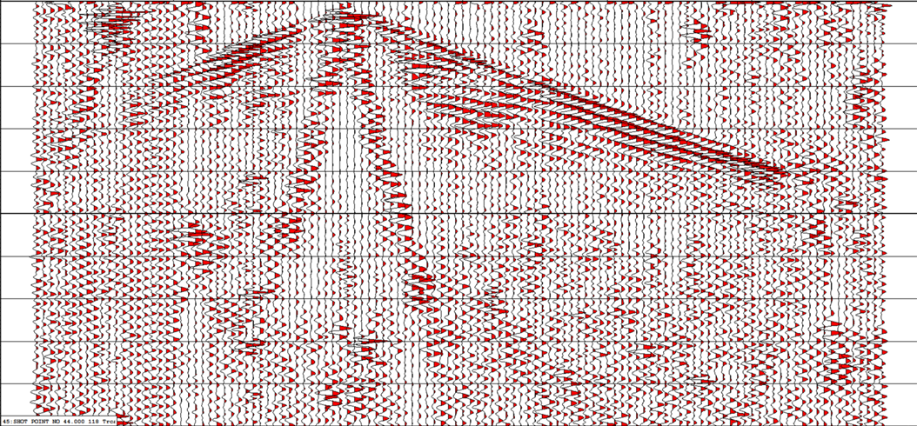
Preliminary Results from Nodes
Receiver #
0
30
60
90
120
100
200
300
400
Time (ms)
500
600
700
800
900
1000
Data acquisition
Geometry setup
Stitch the data (4 days)
Processing
Imaging
Integrated interpretation

Slide 13
Summary and Future Work
P-wave velocities of 400-2350 m/s for the top 800 ms of the near-surface at Léogâne
The stacked section shows multiple discontinuity profiles whose location coincides with the anomalies observed at P and S wave refraction velocity profile retrieval and processing
                Future Work
Further processing of Node data
Gravity modeling
Integration of data
New surveys for late 2013, early 2014
      Possible collaboration for marine shooting, continuous node recording at land
      Ship Vibroseis for 2014 surveys

Slide 14
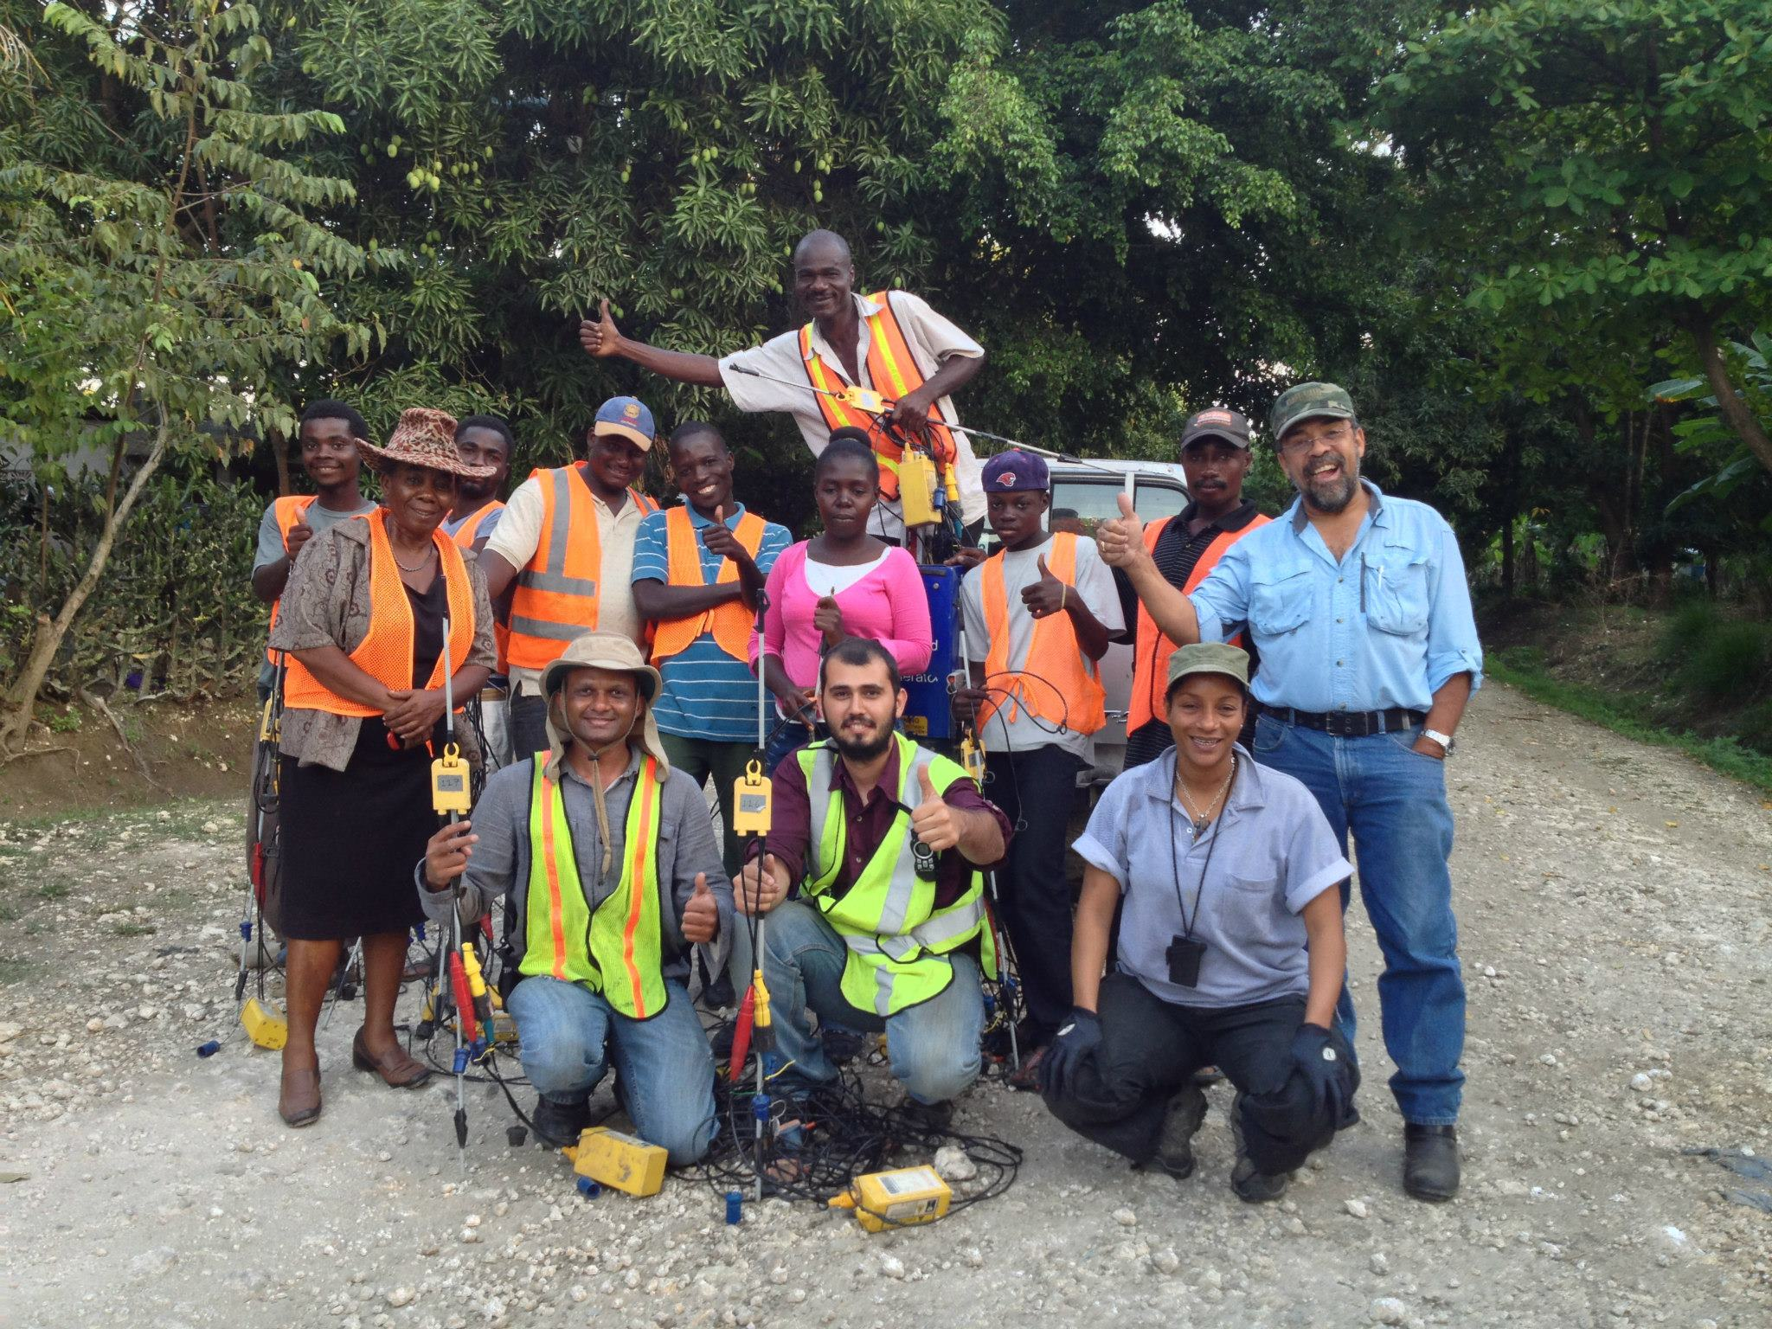
THANK YOU

Slide 15

Allied Geophysical Laboratories
Geoscientists Without Borders
Global Geophysical
Haiti Bureau of Mines and Energy employees
Soumya Roy, Craig Hyslop and Naila Dowla
Gedco-processing software
Acknowledgements

